Slide 1
Fundamentals of Natural Language Processing

Slide 2
Syllabus – Day 1
Introduction
What is Natural Language Processing?
Why learn NLP fundamentals?
Defining NLP Tasks
A primer on linguistics
Word Representations
Preprocessing Operations
NLP Pipeline
Word Embeddings
Explore and Train Word2Vec

Slide 3
Syllabus – Day 2
Transformers
The Transformer Architecture
Introduction to BERT
BERT as a Language Model
BERT for Text Classification
Evaluating Classifiers
Large Language Models (LLM)
What are LLMs?
Prompting to solve NLP Tasks
Using local LLMs with Ollama
Drawbacks and biases with LLMs

Slide 4
Episode 01: Introduction

Slide 5
What is Natural Language Processing (NLP)?
Notes:
(10 slides + 1 challenge + 1 code block) = 25 mins

Slide 6
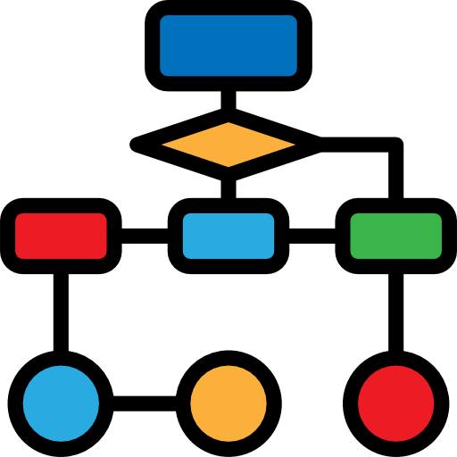


Why “Natural” Language?
Artificial Language:
Computers excel at following
deterministic instructions
Human Language:
Language is ambiguous and
highly context-dependent
Notes:
From CS perspective, languages are artificial, carefully designed with specific syntax and definitions so the computed can follow instructions. Human language emerges “naturally”, and NLP aims at helping computers understand and interact with users using ”natural language”

Slide 7
What is Natural Language Processing?
Computer Science
Artificial Intelligence
Machine Learning
Linguistics
Natural Language Processing
Deep Learning
LLMs
Notes:
Again, from CS prespective… NLP is interdisciplinary and LLMs are the latest subset within NLP, with stringer connections to DL enfineering and weaker linguistic knowledge.

Slide 8
What is Natural Language Processing?
NLP is an area of research and application that focuses on making human languages processable for computers.
More than 7000 human languages are spoken around the world, each with its own grammar, vocabulary, and cultural context.
Today we focus on written English, we leave out speech and video, as they require a different kind of input processing.
Most linguistic concepts remain valid across languages, however they might require different approaches

Slide 9
Challenge 1
Name at least three tools/products that you use on a daily basis and that you think leverage NLP techniques. To do this exercise you may make use of the Web.

Slide 10




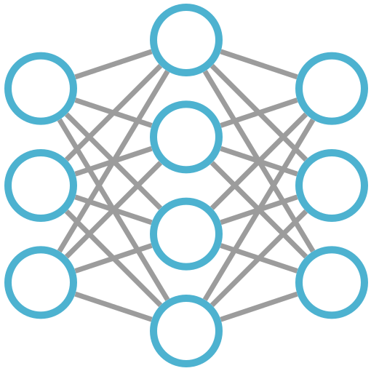
NLP Pipeline
Word Counts
Pre-processing
Rule-based
Post-processing
Text Documents
Data Insights & Evaluation
Machine Learning
Deep Learning

Slide 11
Tokenizing a string…
Text data is represented as “strings” inside computers.
Humans break up texts into words to understand the content. In NLP, a similar process is called tokenization.
This process might seem trivial at first, but even here assumptions and decisions are already required.

Slide 12
[CODE]
First attempt to tokenize strings in python

Slide 13
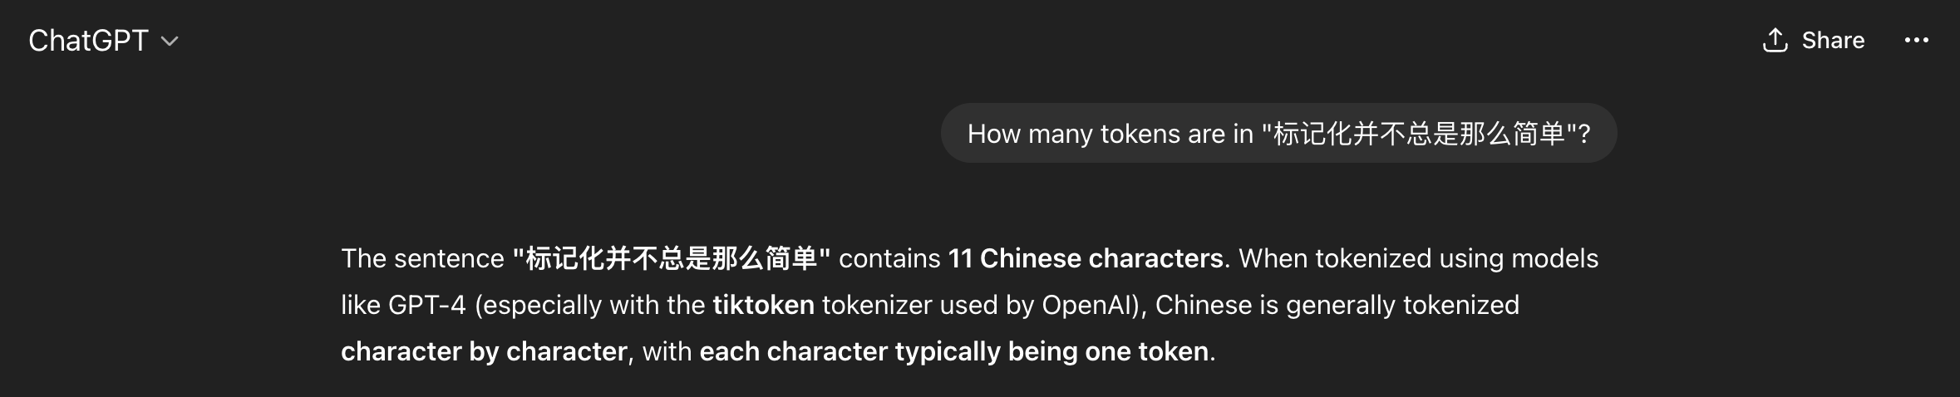
Does the LLM know more than me?

Slide 14
Tokens in Large Language Models
LLM tokenizers do not segment text into human words.
They use tokenizers that have been trained to statistically maximize computing resources and performance in different tasks.
See tiktokenizer

Slide 15
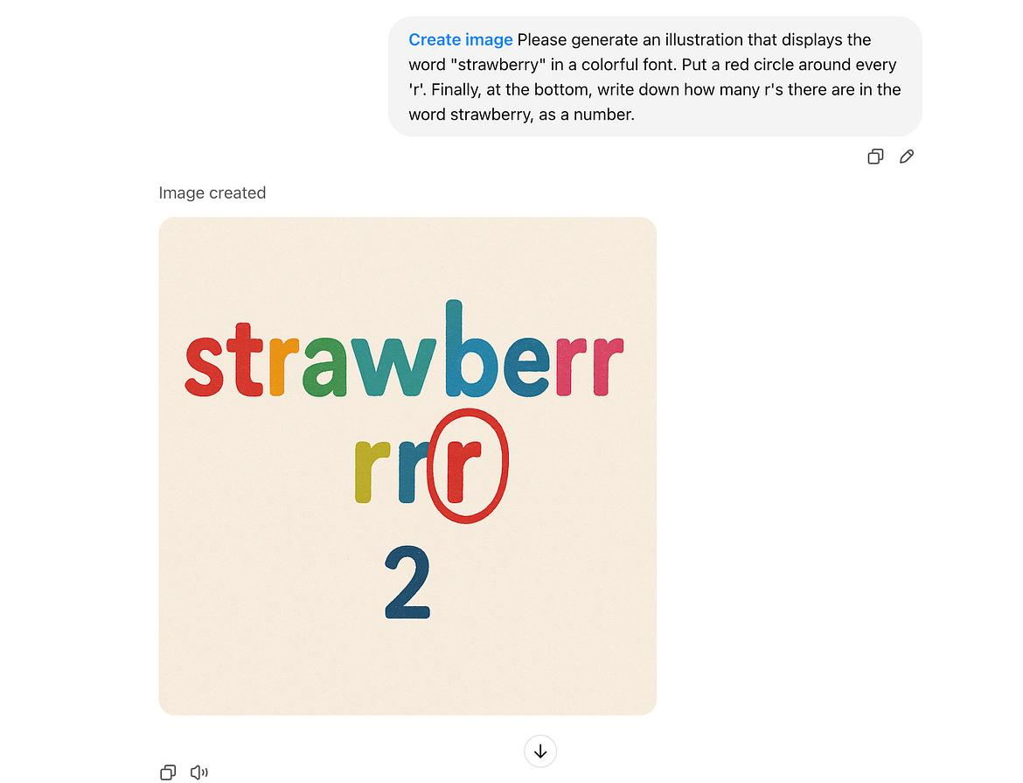
Source: Reddit

Slide 16
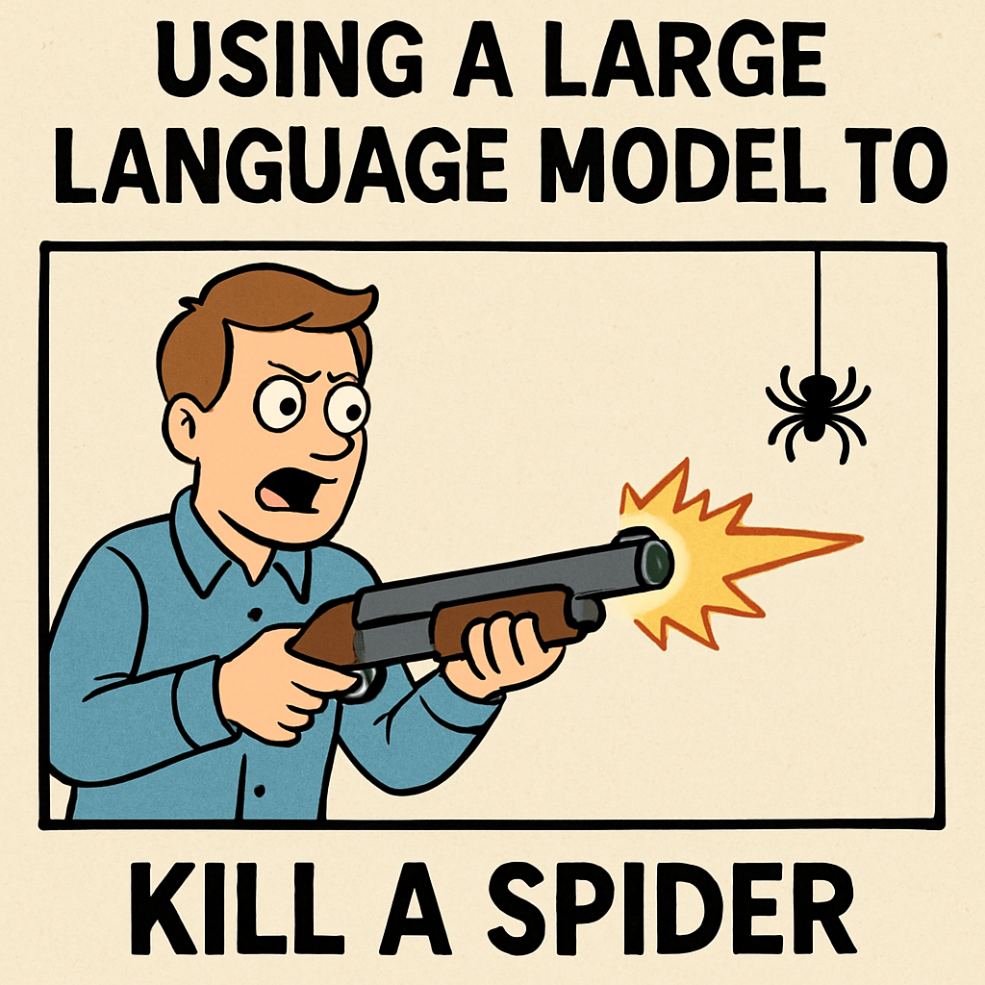
The importance of NLP Fundamentals

Slide 17
The importance of NLP Fundamentals
Learn to formulate the problem → NLP Tasks
What are the limitations of current LLMs? → Linguistics
Can I use a simpler approach to solve it? → NLP Pipelines
How do I validate my results? → Evaluation
If I use an LLM…
How do I know if I can trust the outputs? → All of the above
What are possible sources of errors → All of the above

Slide 18
Language as Data
Notes:
Around 10:10… (5 slides + 1 challenge + 1 code block) = 20 mins

Slide 19

Language as Data
Your first task as an NLP practitioner is to understand what aspects of textual data are relevant for your application
Basic feature examples: word counts, presence of keywords or phrases, sentence length, etc…

Slide 20
Language as Data
Knowing what is relevant, helps you to:
Identify techniques to systematically extract meaningful features from text.
Shape your text into a suitable data format.
Choose an existing model (ML algorithm or neural architecture) that can help solve our problem at hand.

Slide 21



What is a word?
In NLP, words are the most intuitive features you can use.
T
A
B
L
E

Slide 22
What is a word?
A word type is the word in the abstract.
A word token refers to each occurrence of a word in a text.
BEWARE: token and word are not always synonyms, but frequently you will find this simplification.
Next to my dinning table you can see my nice coffee table.
Notes:
(a token can also be punctuation or subwords, etc…

Slide 23
[CODE]
Using spaCy to process text files
See Spacy Docs
Notes:
After finishing this code block, Could be a good stop point for a break… (10:30)

Slide 24
Pre-trained models & Fine-tuning
A pre-trained model has already been optimized on relevant data for a given task, and we can use it right away with our own data. Ideally, publicly released pre-trained models have undergone rigorous testing.
Fine-tuning is a common practice where we take advantage of the knowledge of a related pre-trained model and adjust it using our own data. This usually needs considerably less data compared to starting from scratch.

Slide 25
Challenge 2
Use the spaCy Doc object to compute stats about one book. Example:
Give the list of the 20 most common verbs in the book
List how many Places are identified in the book (Label = GPE)
How many different entity categories are in the book?
Who are the 10 most mentioned PERSONs in the book?
Any other aggregate you like

Slide 26
NLP Tasks
Notes:
10:40 (9 slides + 1 challenge) = 30-40 mins

Slide 27
NLP Task
An NLP task is a well-defined problem that involves applying computational algorithms to achieve a specific linguistic or functional objective.
From the Machine Learning perspective there are supervised and unsupervised tasks.
From the Deep Learning perspective different architectures are optimal for different problems.
Tasks can also be grouped together according to their goals.

Slide 28
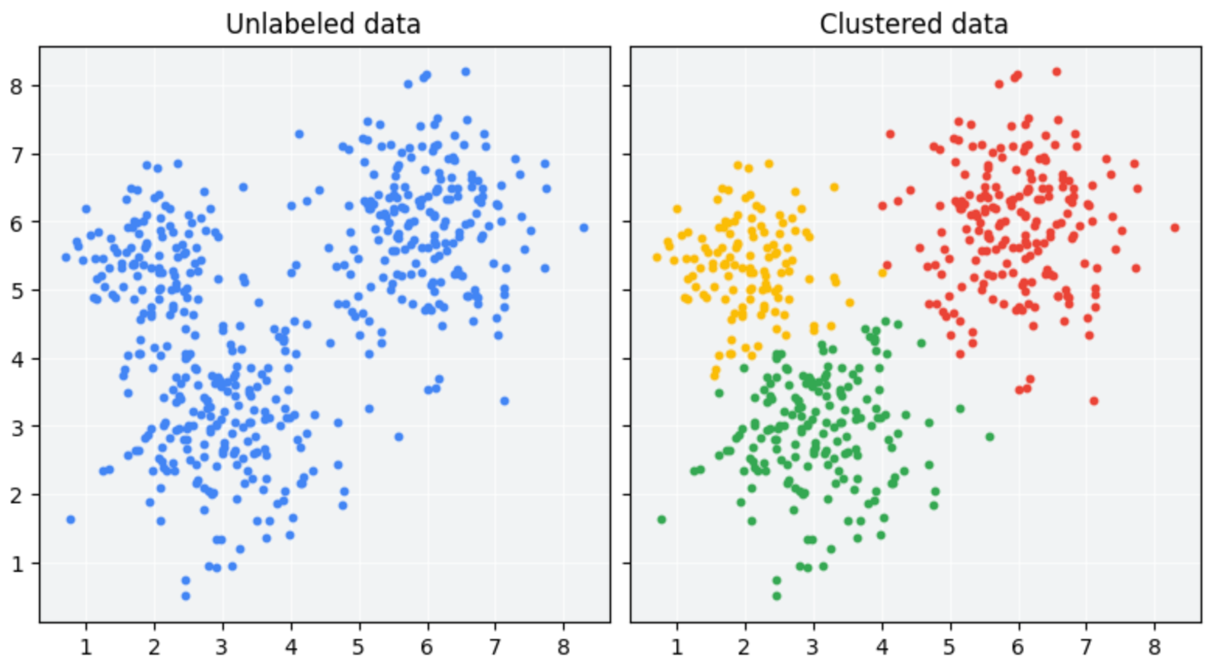
Unsupervised Learning
Exploiting existing patterns from large amounts of text.
Notes:
There is also self-supervised, where we use text itself as supervision (for example a window of words around a target word)

Slide 29
Supervised Learning
Classify texts given a labeled set of examples
The model learns from a manually labeled training set and hopefully generalizes to unseen examples

Slide 30
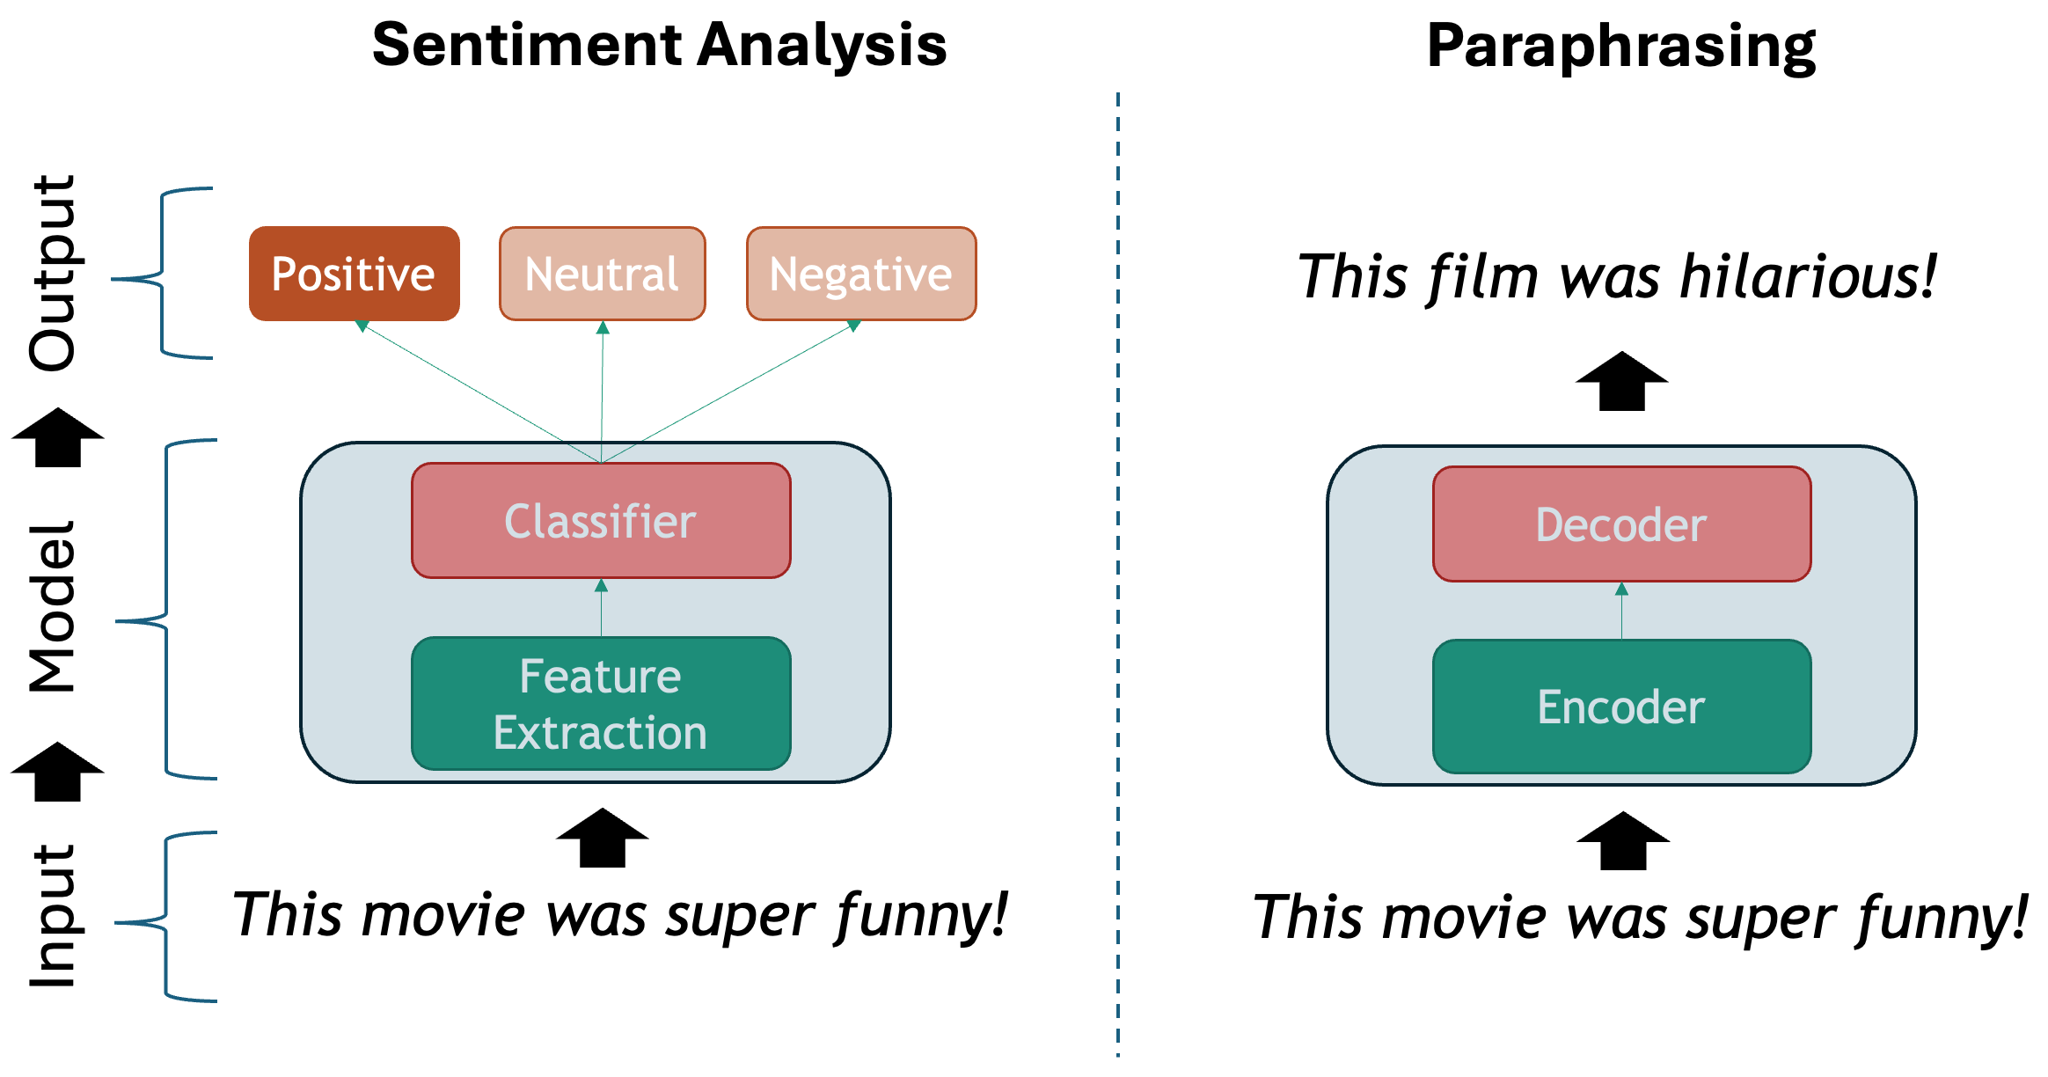
Supervised Learning

Slide 31
Natural Language Processing Tasks
Language Modeling
Text Classification
Token Classification
Text Similarity
Language Identification
Span Filtering
Authorship Attribution
Sentiment Analysis
POS Tagging
Word Sense Disambiguation
Named Entity Recognition
Document Clustering
Plagiarism Detection
Topic Modeling
Information Retrieval
Text Generation
Machine Translation
Summarization
Paraphrasing
Question Answering
Chatbot
Entity Linking
Co-reference Resolution
Notes:
Important to look mostly at the top categories. Your task might be close enough to other subtasks, and you could learn to shape your data that way
Also important to mention that most tasks can be done supervised and unsupervised way (with different degrees of success)

Slide 32


Text Classification
A single label is assigned to a chunk of text (phrase, sentence, paragraph, document)
The book was a complete failure, it was long, boring and badly written
Classifier
NEGATIVE
You are great!
Classifier
POSITIVE
Notes:
Can be supervised (labeled examples) or unsupervised (clustering)

Slide 33
Token Classification
One label per token is assigned. The whole surrounding sequence is considered to determine which label to assign.
B-PER
I-PER
O
B-BOOK
O
B-DATE
O
NAMED ENTITY CLASSIFIER
Mary
Shelley
wrote
Frankenstein
around
1816
.
len(Inputs) == len(Outputs)
Notes:
Supervised Task

Slide 34
Language Modeling
Predicting the next word given a sequence of “history” words
Classifier
Mary
Shelley
Mary
Shelley
Classifier
wrote
Mary
Shelley
wrote
Classifier
Frankenstein
Classifier
around
Mary
Shelley
wrote
Frankenstein
Classifier
Mary
Shelley
wrote
Frankenstein
around
1816
Notes:
Learning probabilities of words given a surrounding text. In this simplified example the “labels” are the individual words. This is also called self-supervised sometimes.

Slide 35
Text Generation
Learn to generate a target sequence given a source sequence and the context so far...
Parallel Corpus:
FR: Je sui étudiant
EN: I am a student
I
am
a
student
Je sui étudiant
ENCODER
DECODER
<S>
I
am
a
len(Inputs) != len(Outputs)

Slide 36
Challenge 3
Look at the NLP Task taxonomy described above and write down a couple of examples of (Input, Output) instance pairs that you would need in order to train a supervised model for your chosen task.

Slide 37
A Primer on Linguistics

Slide 38
A primer on linguistics
Language is hard to process because it is:
Compositional: structures are more than the additions of their parts
Ambiguous: the same symbols change meaning depending on the context
Discrete: words are arbitrary non-measurable symbols
Sparse: concrete phenomena occur only a handful of times

Slide 39
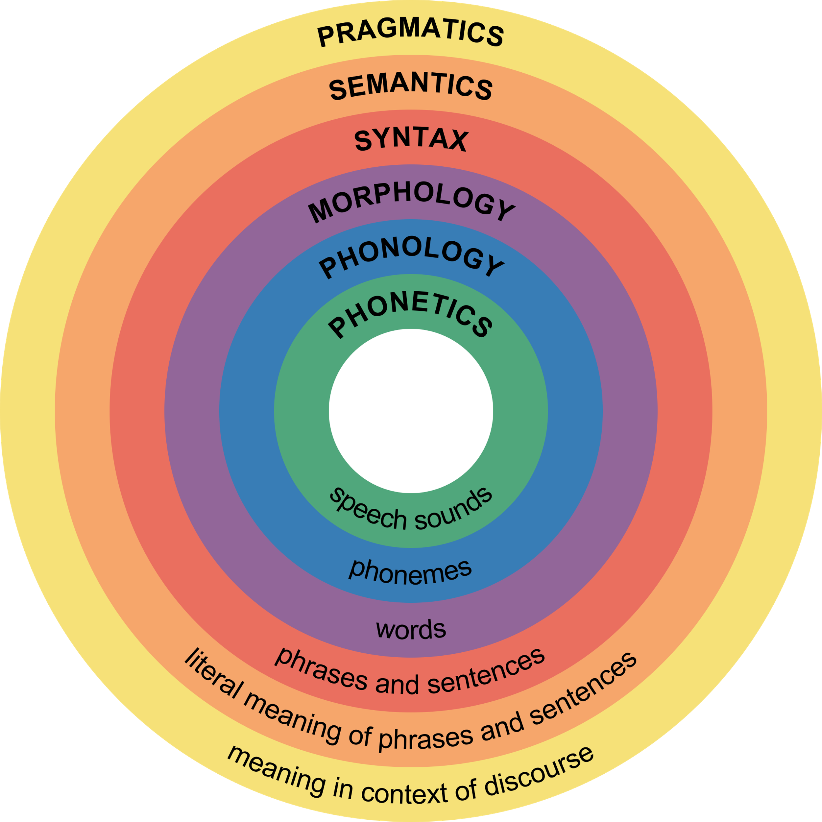
Levels of Language

Slide 40
Challenge 4 (In pairs)
Discuss why the following sentences are special. To what level of language does each case belong?
The door is un-lockable from the inside
Unfortunately, the cabinet is unlock-able, so we can’t secure it
I saw the cat with the telescope
I saw the cat with the stripes
Please don’t drive the cat to the vet!
Please don’t drive the car tomorrow!
I never said she stole my money
I never said she stole my money
I never said she stole my money

Slide 41
[CODE]
Exercises to see linguistic phenomena

Slide 42
Episode 02: From words to vectors

Slide 43
Preprocessing Operations
Notes:
2 slides + 1 big code block (30 mins)

Slide 44
Data Granularity
word level: detecting abusive language (based on a known vocabulary).
sentence level: extracting entities in each sentence, individually.
chunks of text: (paragraphs or chapters), extracting key ideas (summarizing) each paragraph in a document.
document level: For example, each full book should have one genre tag (Romance, History, Poetry).

Slide 45
Common Operations
Data Formatting:
Extract text strings from documents formats (word, pdf, etc…)
Remove unwanted content
Clean your text as much as possible.
Tokenization: extract words or sentences.
Lowercasing: make the text more homogeneous.
Lemmatizing: keep only dictionary-entry words.
Stopword Removal: get rid of non-interesting words.

Slide 46
NLP Pipeline
Notes:
1 slide + 1 challenge = 30 mins

Slide 47
Example: Rule-based Classifier
Contains POSITIVE words
Extract Sentences
For each Sentence
Yes
POS
No
Contains NEGATIVE words
No
Yes
NEUT
NEG
Rule-based Model

Slide 48
Challenge 1
Think about the pros and cons of the proposed NLP pipeline:
Do you think it will give accurate results?
What do you think about the coverage of this approach? What cases will it miss?
Think of possible drawbacks of chaining components in a pipeline.

Slide 49
Word Embeddings

Slide 50
Neural Networks
Layer_In
Layer_H
Layer_Out
Input
-0.3
Output
0.89
0.01
I am a happy sentence
0.09
POSITIVE
-0.7
0.02
0.95
After seeing thousands of examples, each layer represents different “features” that maximize the success of the task, but they are not human-readable

Slide 51
Word Embeddings Layer
Source: https://developers.google.com/machine-learning/guides/text-classification/images/EmbeddingLayer.png

Slide 52

Training Data Word2Vec
Source: https://mccormickml.com/2016/04/19/word2vec-tutorial-the-skip-gram-model/

Slide 53
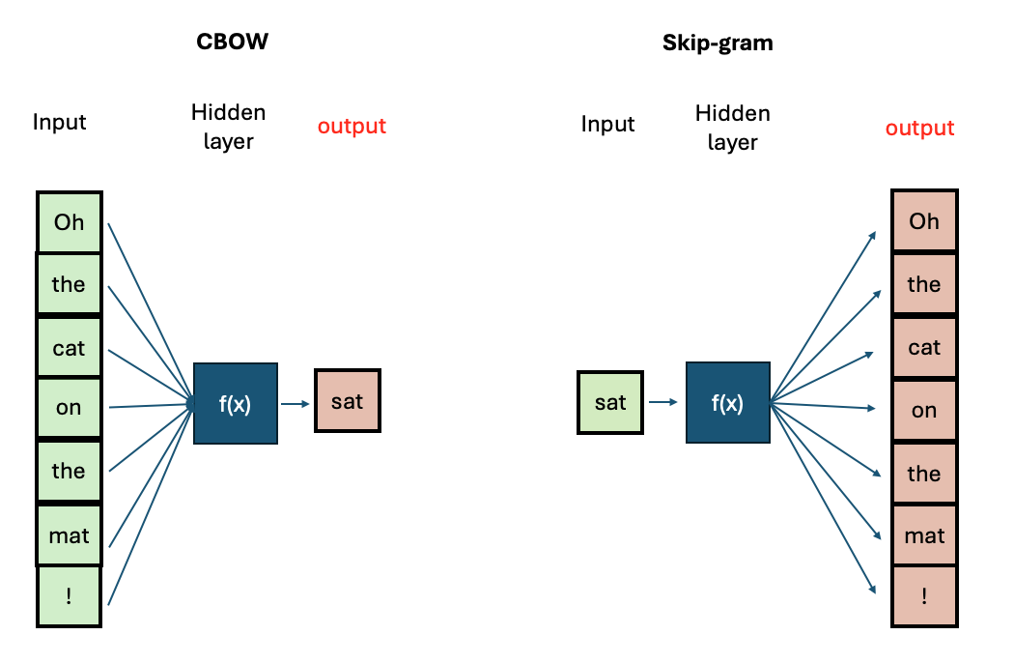
Training Algorithms Word2Vec

Slide 54
Word2Vec Neural Network
Layer_In
Layer_H
Layer_Out
Inputs
Outputs
0.3
cat
the
0.01
The cat sleeps
cat
-0.7
sleeps
0.95
The NN maps a source word into a target word from the original context. After being trained, we are just interested in the hidden layer that holds the pre-trained Word Embeddings

Slide 55
[CODE]
Explore Word2Vec Space

Slide 56
Challenge 2
Think of different word pairs and try to guess how close or distant they will be from each other.
Use the similarity measure from the word2vec module to compute the metric and discuss if this fits your expectations. If not, can you come up with a reason why this was not the case?

Slide 57
[CODE]
Train your own Word2Vec

Slide 58
Episode 03: Transformers & BERT

Slide 59
Transformers

Slide 60
Word2Vec Limitations
Each word is processed in isolation
Fixed Vocabulary Size (e.g. 10K words)
Fixed Vector per item in vocabulary
Word2Vec
fine
[0.935, 0.2109, …. -0.539]
Word2Vec
watch
[-0.943, 0.342, …. 0.737]
Word2Vec
bazzinga
ERROR!

Slide 61
Challenge 1
Think of (at least 2) different words that can have more than one meaning depending on the context.
Come up with one simple sentence per specific meaning and explain what they mean in each context.
How do you know what of the possible meanings does the word have when you use it?

Slide 62
The Transformer
Maria houdt van Groningen
DECODERs
Transformer
ATTENTION
ENCODERs
TOKEN EMBEDDER
“Maria loves Groningen”

Slide 63
The Transformer
Maria houdt van Groningen
DECODERs
Transformer
ATTENTIONs
ENCODERs
TOKEN EMBEDDER
“Maria loves Groningen”
Notes:
A transformer is an “NLP Pipeline” of its own. The difference is that now all components are interconnected neural networks and we do not get independent access to each component.

Slide 64
Encoder
The encoder is trained to compress any sequence of tokens into a fixed-size vector.
Sentence Embedding
Token Embeddings
ENCODER
Maria
loves
Groningen
TOKEN EMBEDDER
“Maria loves Groningen”

Slide 65
Decoder
The decoder is the generative model. Emits one token at a time, conditioned on the compressed input + previous emitted tokens
Maria houdt van Groningen
DECODER
Sentence Embedding OR Attention Vector

Slide 66
Attention Mechanism
Maria houdt van ???
With attention, the decoder has the opportunity to double check into the source each time it emits the next token
Attention learns relevance of components across source and target sequences
DECODER
Maria loves Groningen
ENCODER
TOKEN EMBEDDER
“Maria loves Groningen”

Slide 67
Challenge 2 (In pairs)
In pairs, think of 1 short but interesting sentence in English (langA) and come up with its translation into a second language (langB):
Draw arrows between the words or phrases from langB to langA that mean the same. Is it always possible to do this mapping one to one?
How does this relate to attention?

Slide 68
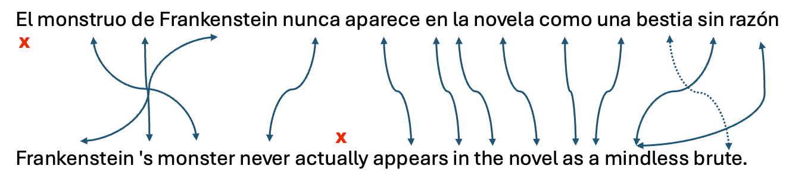
Challenge 2: Solution

Slide 69
BERT

Slide 70
BERT Architecture
Example:
BERT-base
H
H
H
H
H
H
H
Each token vector has
768 dimensions
ENCODERs (BERT)
12 Encoders are s
tacked together
[CLS]
Maria
loves
G
##ron
##ingen
[SEP]
It’s input size is
always 512 tokens
“Maria loves Groningen”

Slide 71
Training BERT
TASK1: Masked Language Model
TASK2: Next Sentence Prediction
you
…
cheese
…
me
0.11
0.38
0.05
Output
BERT
H
Encoder
“Maria loves [MASK] sandwiches”

Slide 72
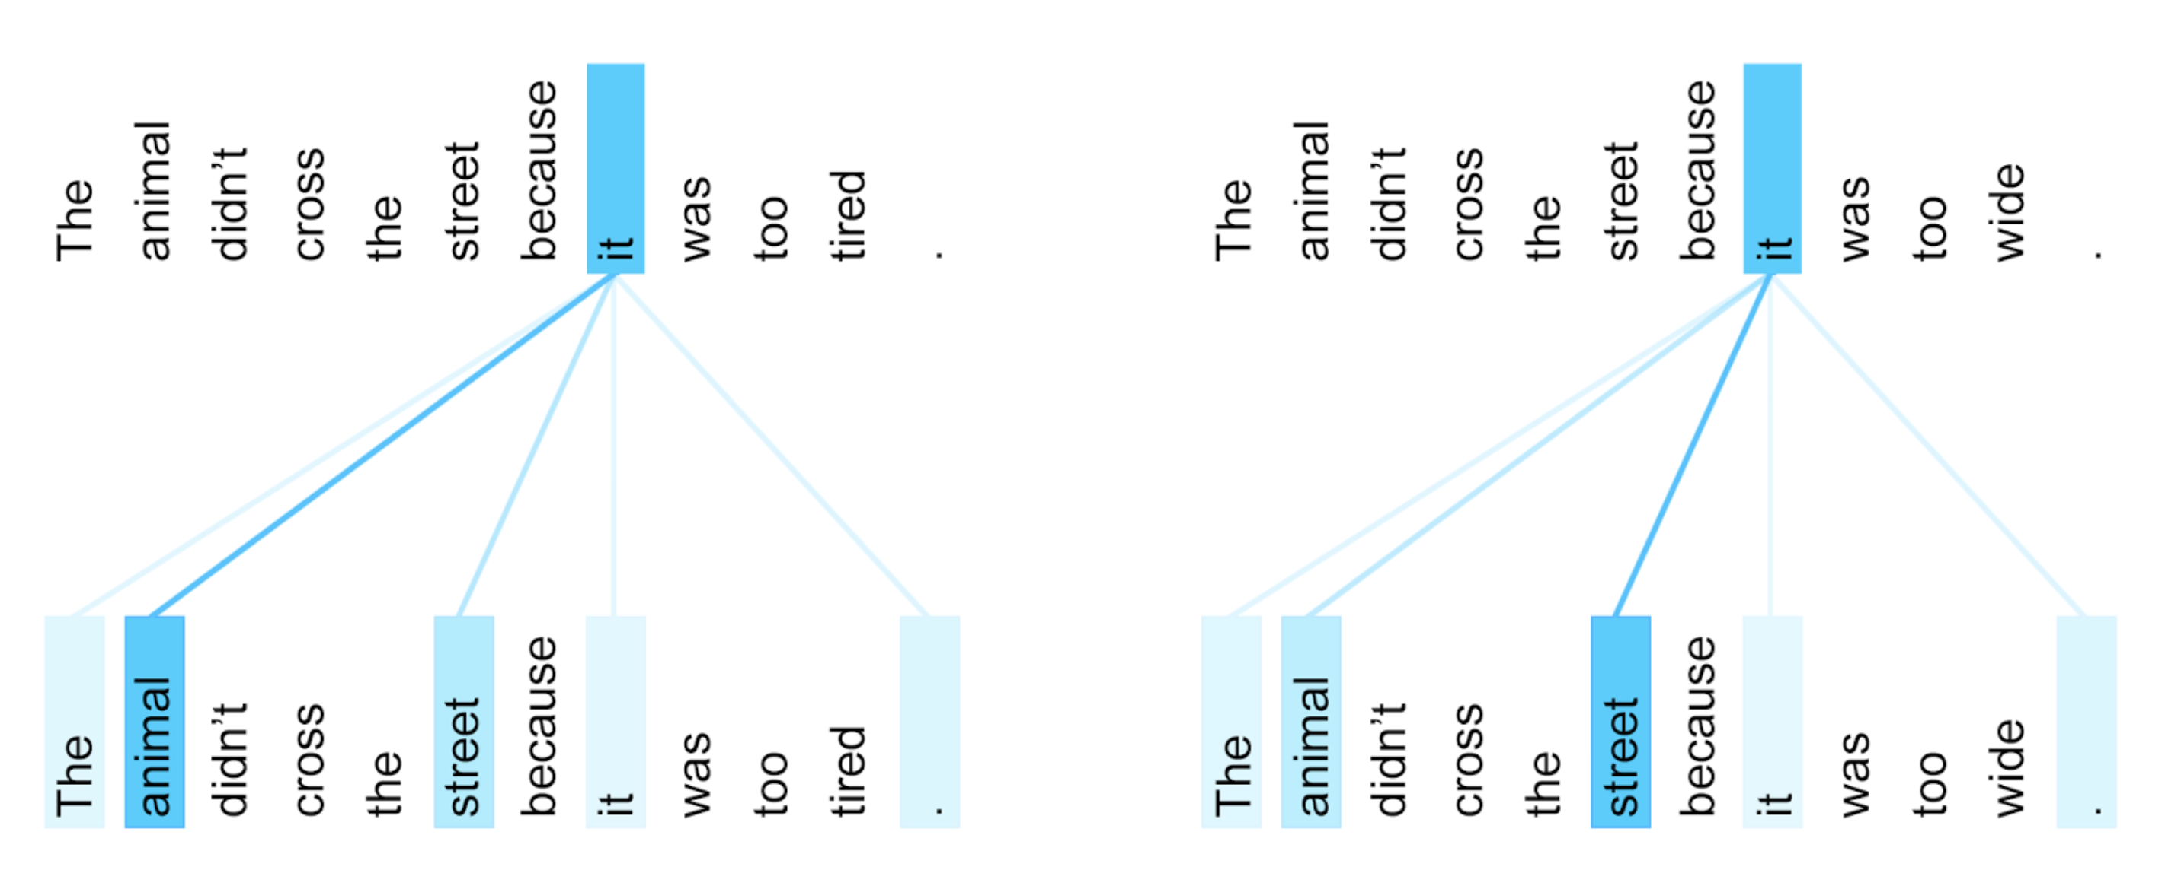
BERT: Self-Attention
The BERT encoder has an internal attention component, which enhances contextual learning.
Example: Coreference Resolution

Slide 73
[CODE]
BERT Tokenization: Word Pieces

Slide 74
[CODE]
Polysemy in BERT: Obtain contextualized vectors

Slide 75
[CODE]
BERT as Language Model: Fill-in the blank!

Slide 76
Challenge 3
Play with the `fill-mask` predictions
Intuitively try to find good and bad prediction examples
You can test different `top_k` parameters and/or use the multilingual model `bert-base-multilingual-cased`
Can you explain the intuitions behind the predictions?

Slide 77
HuggingFace Pipeline
The pipeline() is very useful to test models,
It supports dozens of tasks, including multimodal models.
Careful: It wraps different model architectures!
If you need more flexibility you will have to use the tokenizer and model inference separately.
See pipeline() docs

Slide 78
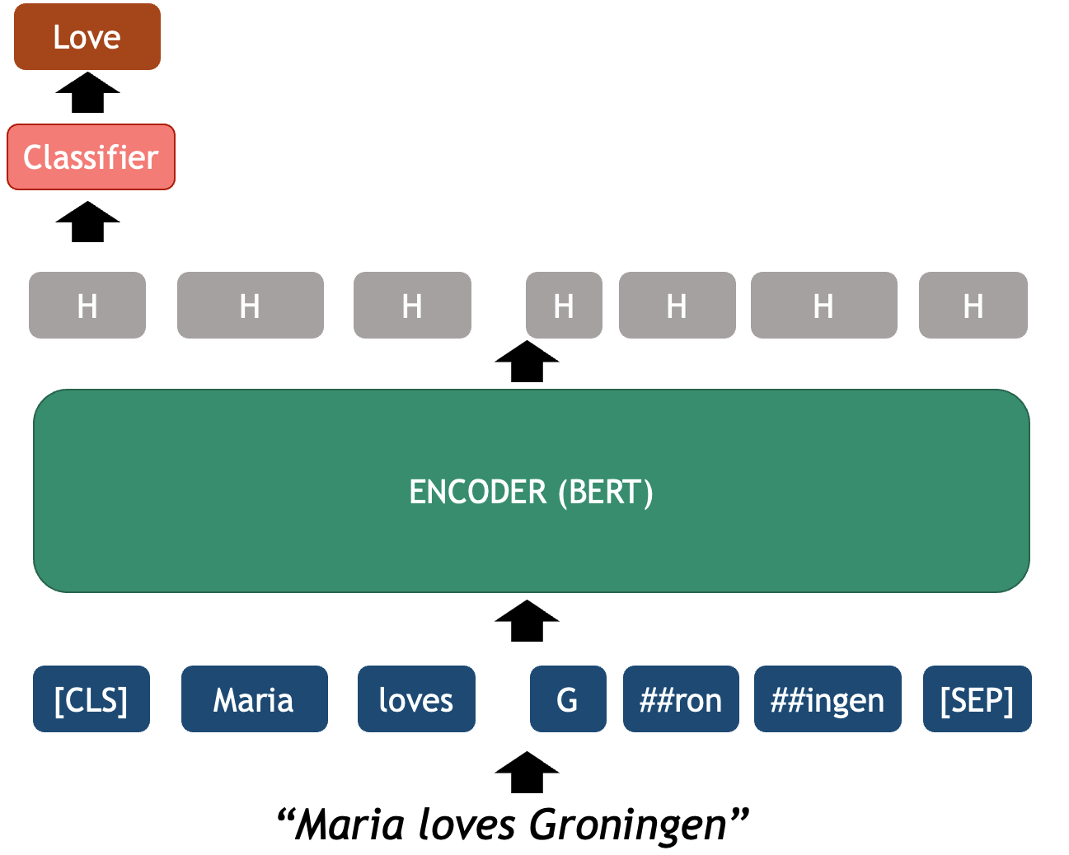
BERT for Text Classification

Slide 79
[CODE]
BERT-based Sentiment Classifier

Slide 80
Model Evaluation

Slide 81
Model Evaluation
The purpose of evaluation metrics is to understand how well the model generalizes to unseen cases.
Why Evaluate supervised models (classification)?
If you trained your own model, you should measure performance on a held-out test set, to avoid overfitting.
If you use a pre-trained model, it prevents overconfidence on external performance claims.
The most basic metric is accuracy, how many times did the model got it right? But it is often not enough…

Slide 82
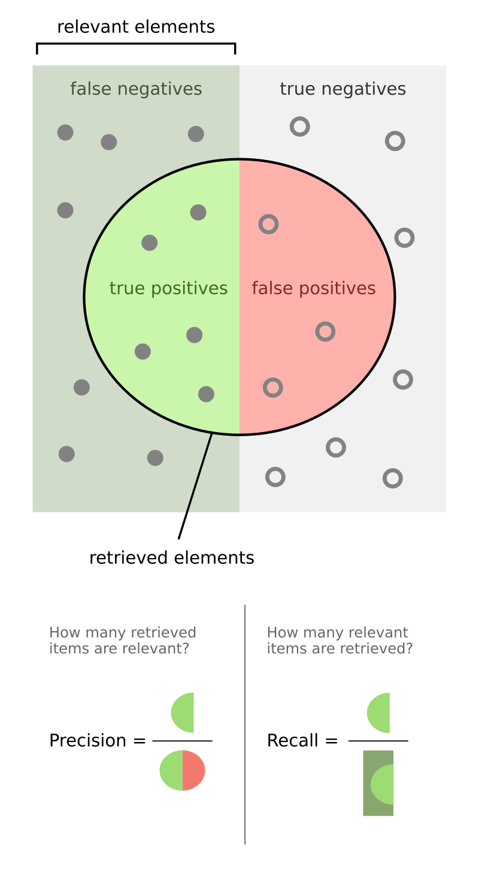
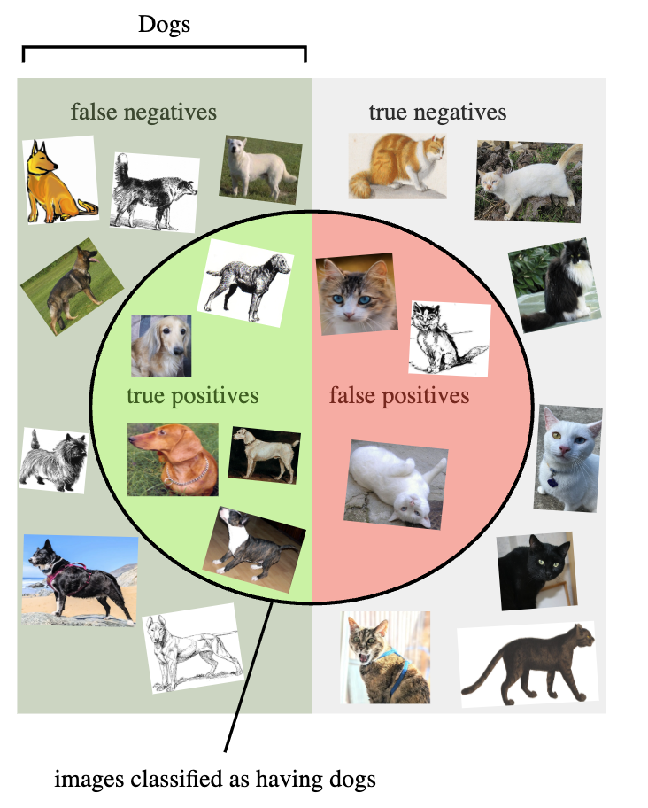
Metrics for Classifiers
Each metric measures performance for each class independently
Precision: Of predictions made, how many were correct?
Recall: Of actual cases, how many did we catch?
F1-Score: “Balance” between precision and recall
Source: Wikipedia

Slide 83
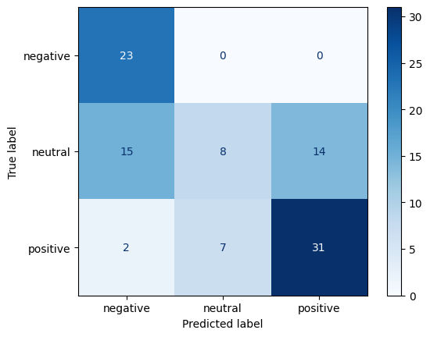
Confusion Matrix
Basic observability to model predictions
Identify biases for specific label classes. Which classes your model predict well vs. poorly?
Take steps to improve performance. Which classes need more training data?

Slide 84
Challenge 4
Use the provided file to evaluate a sentiment classifier
File: sentiment_film_data.tsv
Use this model: "tabularisai/multilingual-sentiment-analysis"

Slide 85
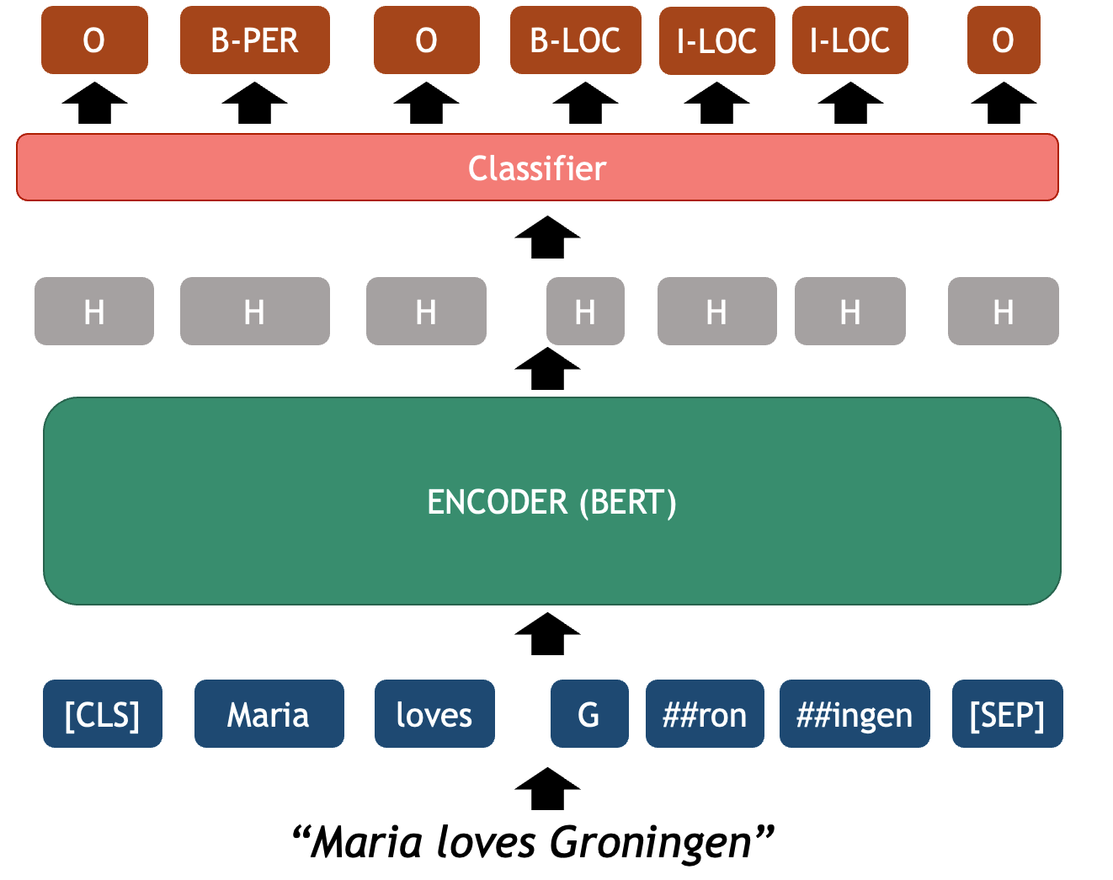
BERT for Token Classification

Slide 86
[CODE]
BERT-based Named Entity Recognizer

Slide 87
Episode 04: Large Language Models (LLMs)

Slide 88
What are LLMs?
There is no single definition for this term. Here we will define it as:
Large language models (LLMs) are generative transformer-based language models that are trained to interact in a conversational-like manner with humans.
The term Large refers to the amount of parameters and training data compared to previous Transformers.
They do not only predict the next most likely token (LM) but have been trained to follow instructions (chat assistant).

Slide 89
Are LLMs “Generative AI”?
Maria houdt van Groningen [END]
X
DECODER = Generative LLM
[START] Maria houdt van Groningen [END]

Slide 90
Are LLMs “Generative AI”?
What is 1 + 1 ? [LLM] It is 2 . [END]
DECODER = Generative LLM
[USER] What is 1 + 1 ? [LLM] It is 2 . [END]

Slide 91
Are LLMs “Generative AI”?
What is 1 + 1 ? [LLM] ????????????
DECODER = Generative LLM
[USER] What is 1 + 1 ? [LLM]

Slide 92
Are LLMs “Generative AI”?
What is 1 + 1 ? [LLM] It
DECODER = Generative LLM
[USER] What is 1 + 1 ? [LLM]

Slide 93
Are LLMs “Generative AI”?
What is 1 + 1 ? [LLM] It
DECODER = Generative LLM
[USER] What is 1 + 1 ? [LLM] It

Slide 94
Are LLMs “Generative AI”?
What is 1 + 1 ? [LLM] It is
DECODER = Generative LLM
[USER] What is 1 + 1 ? [LLM] It

Slide 95
Are LLMs “Generative AI”?
What is 1 + 1 ? [LLM] It is
DECODER = Generative LLM
[USER] What is 1 + 1 ? [LLM] It is

Slide 96
Are LLMs “Generative AI”?
What is 1 + 1 ? [LLM] It is 2
DECODER = Generative LLM
[USER] What is 1 + 1 ? [LLM] It is

Slide 97
Are LLMs “Generative AI”?
What is 1 + 1 ? [LLM] It is 2
DECODER = Generative LLM
[USER] What is 1 + 1 ? [LLM] It is 2

Slide 98
Are LLMs “Generative AI”?
What is 1 + 1 ? [LLM] It is 2 .
DECODER = Generative LLM
[USER] What is 1 + 1 ? [LLM] It is 2

Slide 99
Are LLMs “Generative AI”?
What is 1 + 1 ? [LLM] It is 2 .
DECODER = Generative LLM
[USER] What is 1 + 1 ? [LLM] It is 2 .

Slide 100
Are LLMs “Generative AI”?
What is 1 + 1 ? [LLM] It is 2 . [END]
DECODER = Generative LLM
[USER] What is 1 + 1 ? [LLM] It is 2 .

Slide 101
LLMs vs Transformers
Scale
Training Parameters
Training Data Size
Context Window Size
Post-training
Supervised Fine Tunning (SFT). NLP Tasks, Coding, “Reasoning”…
Reinforcement Learning with Human Feedback (RLHF). What do human users prefer?
Specific Safety Guardrails
Generalization
Scalability promotes unseen correlations

Slide 102
“Open Source” and LLMs
Open code: the actual source code that was used for pretraining is available to modify.
Open training data: release or at least detailed description of the text data used for pretraining.
Open-weights: release the trained model parameters while keeping training code or data proprietary.
Open architecture: normally a paper describes the neural network architecture and specific configuration they used for training.
Commercial models: non-transparent, accessed only through APIs and optimized for user engagement.

Slide 103
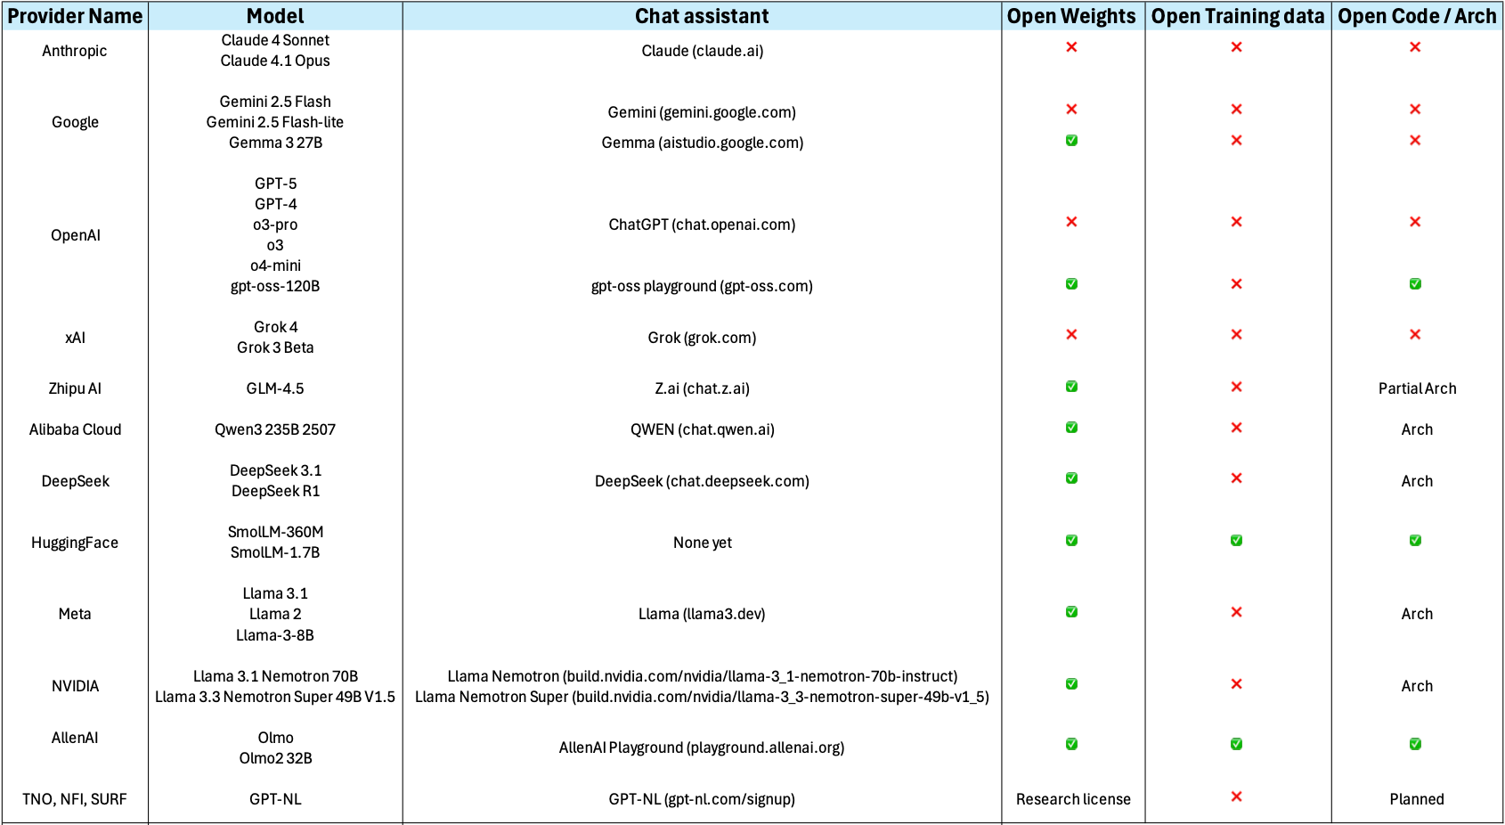

Slide 104
[CODE]
LLM Interaction: Basic Text Generation

Slide 105
[CODE]
LLM Interaction: Multi-turn Conversation

Slide 106
Common Hyperparameters
Max_tokens: hard limit in terms of tokens (not words!) for LLM output
Temperature:
0 greedy decoding (always pick the most likely token)
1 sample from LLM probabilities,
> 1 flattens the probability, so unlikely tokens become more likely
Top_p: only allow to sample from the top_p most prominent tokens
Top_k: hard limit on top_k tokens to sample (e.g. Top 10 tokens)

Slide 107
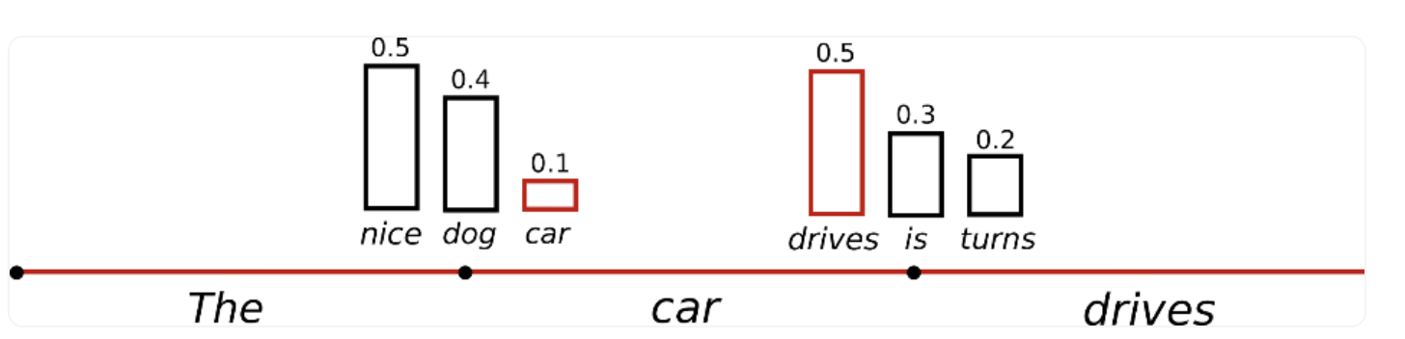
Sampling (Top K)
Top_k = 3
Source: HuggingFace

Slide 108
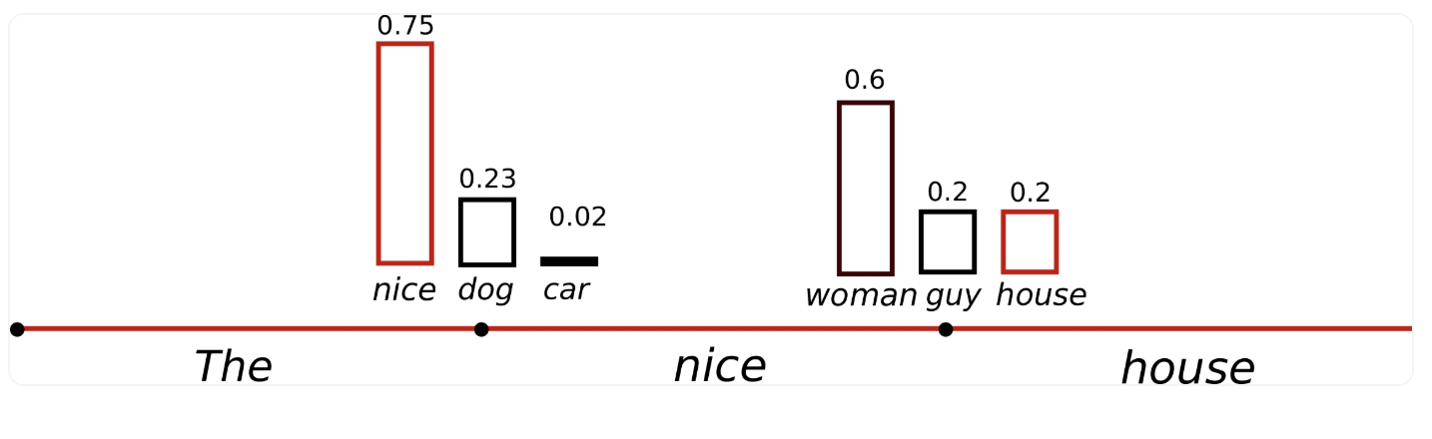
Temperature
Temperature = 1
Temperature = 0.7
Source: HuggingFace

Slide 109
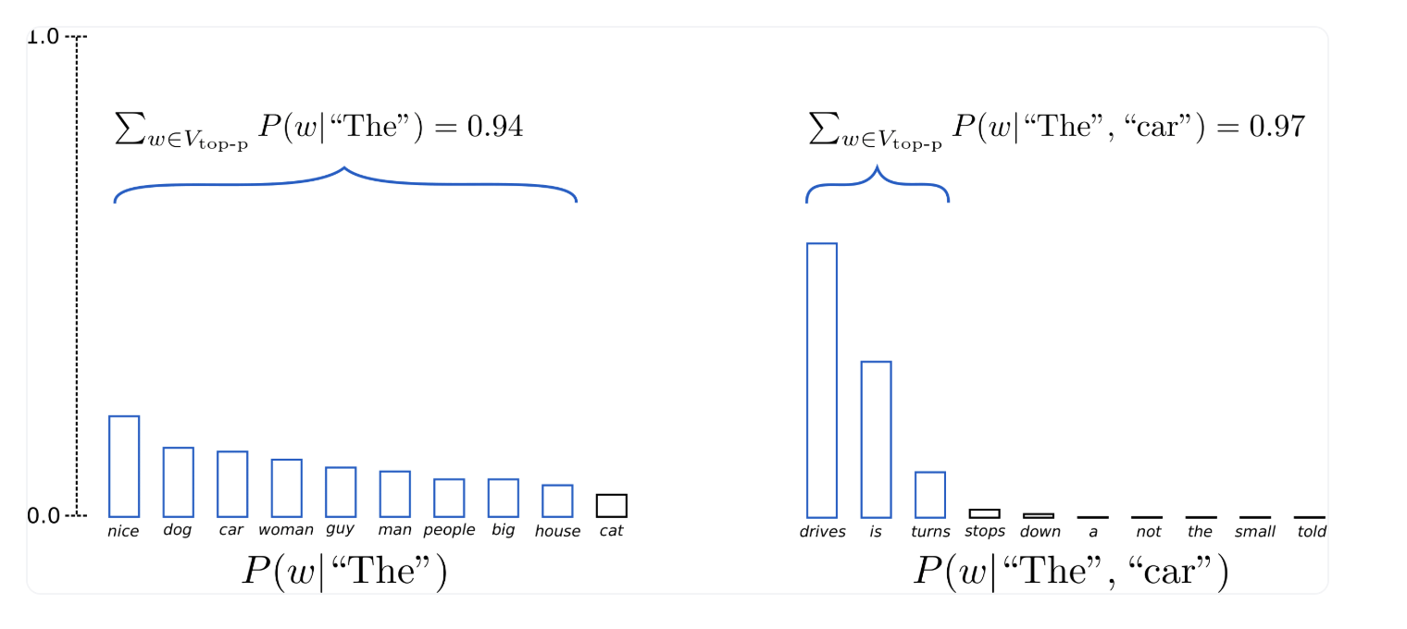
Top_p
Top_p = 0.92
Source: HuggingFace

Slide 110
[CODE]
LLM Interaction: Experiment Hyperparameters

Slide 111
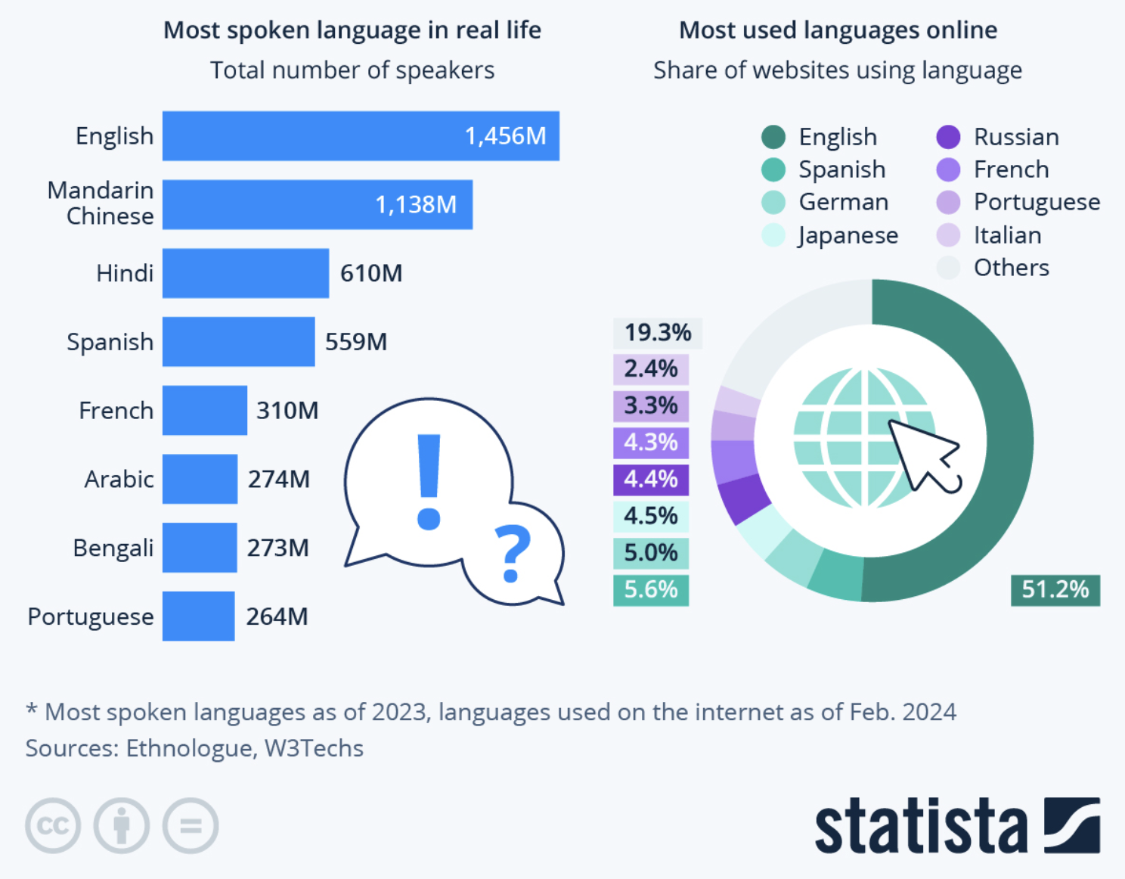
Biases
Hallucinations
Non-determinism
Gender Bias
Informational Bias
Outdated Knowledge
Source: Statista

